Slide 1




Powered By:

Slide 2


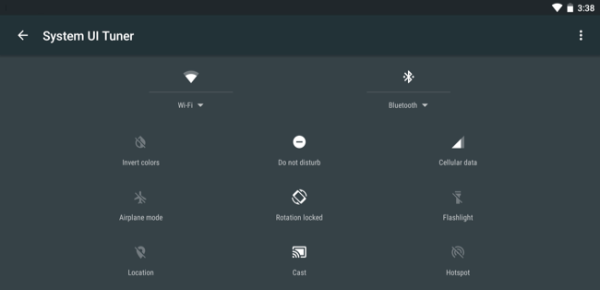



Solution
Problem
ParkCure provides IoT(Intenet of Things) based services where Space Owners can rent their private space and users can buy that space for certain time
Money and Time wasted for proper parking spot
No way of booking a confirmed parking spot
Lots of spaces goes unused everyday in out
People forget to carry change

Slide 3
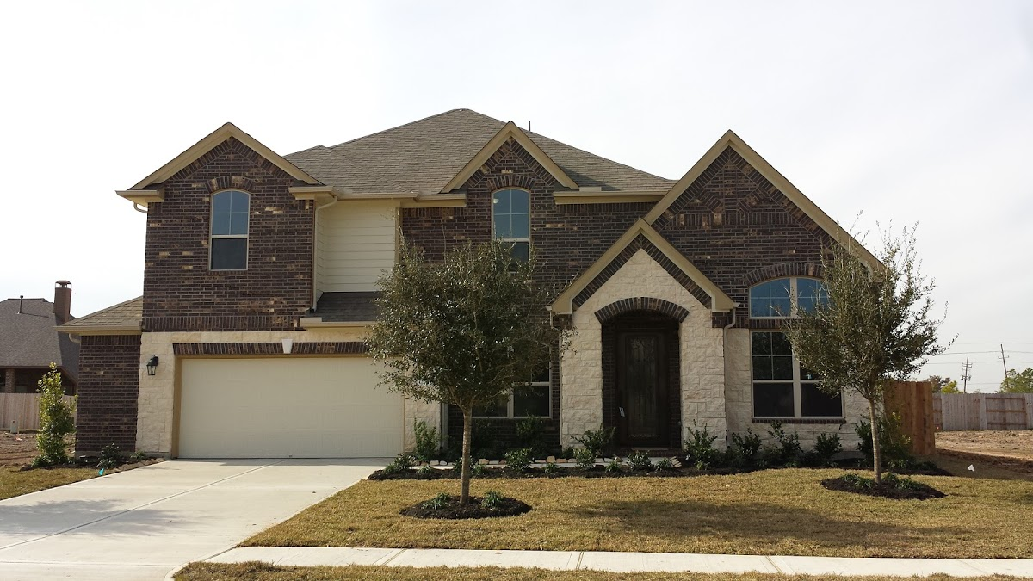
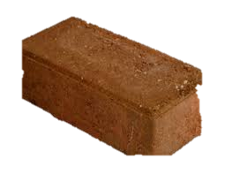
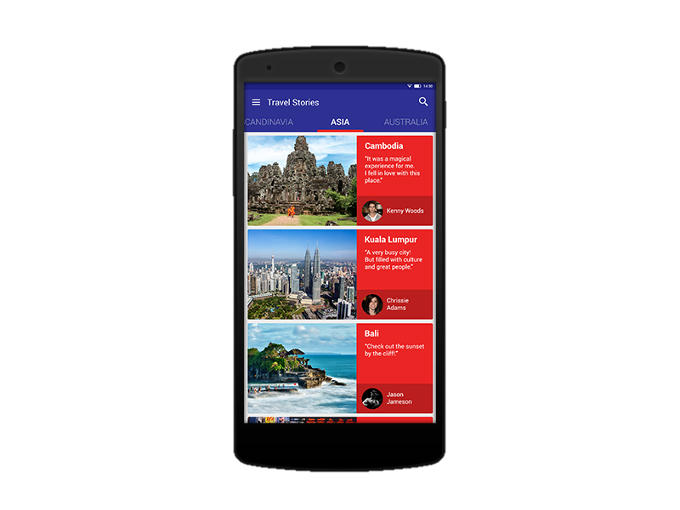
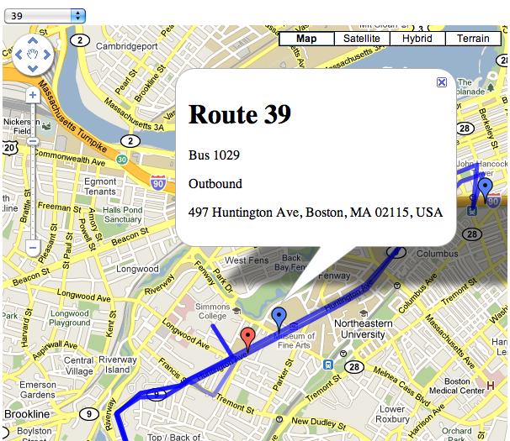
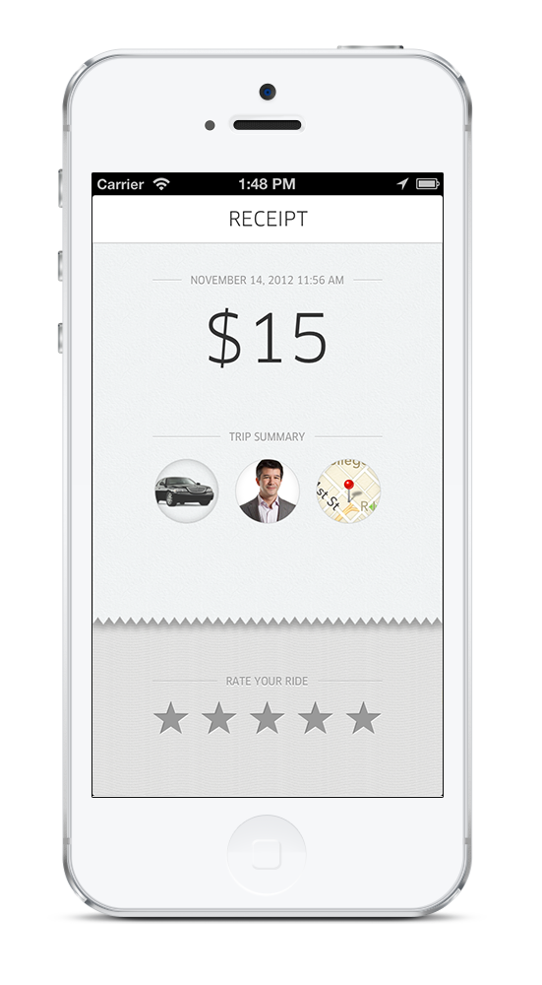
How does it work?
Riverside Drive
John Smith
Book Now!

Slide 4
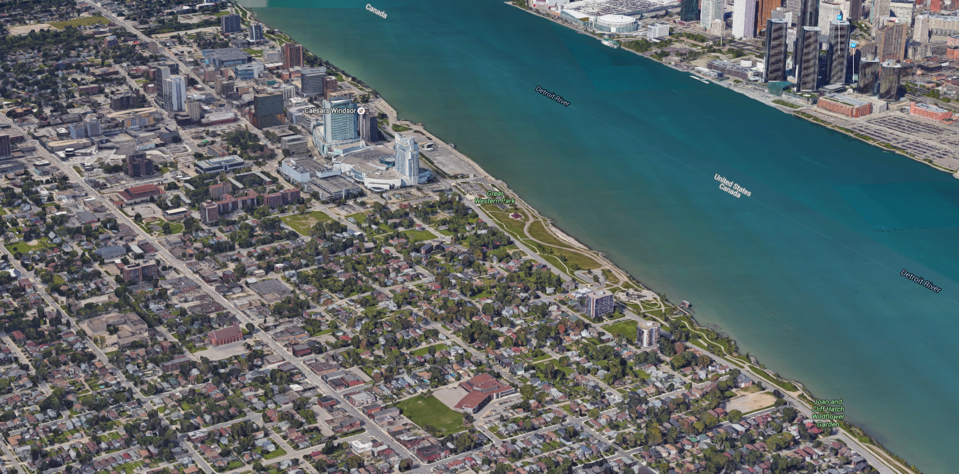
Use Case I

Slide 5
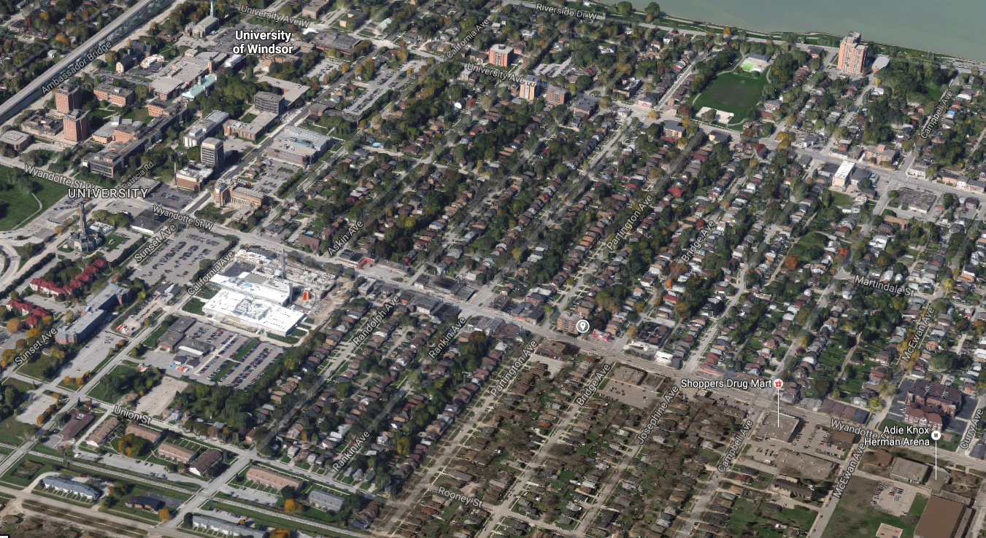
Use Case II

Slide 6



Market Validation
Craigslist
Roost
5,000 temporary parking spaces in Toronto alone
Roost is worth about 6M
dollar as of 2016

Slide 7

Market Size

Slide 8

Revenue Model
Transaction
Revenue Model
Sensor
Revenue Model
Revenue will also be generated from selling of Sensors
Prototype sensor cost around $60. So we will sell the sensor for $80.
Each transaction we will charge 20%, of which 3-4% goes to VISA/PAYPAL.
App will be free

Slide 9

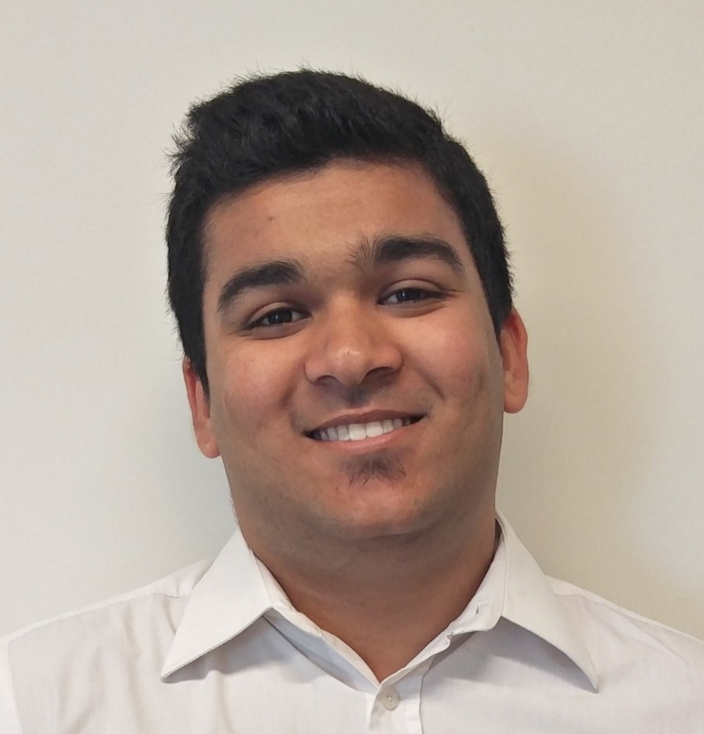
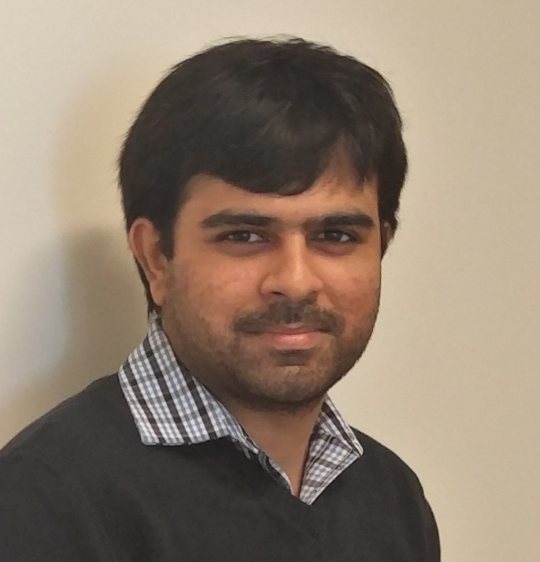
Team

Slide 10
Patents Potential
Streetline makes parking sensors for public and commercial parking spaces.
Streetline currently holds 3 patents for their wireless mesh technology.
ParkCure has potential for patent
for its low consumption real
time sensor.
Other potential, ParkCure’s Internet
Of Things technology can be applied
into various field.

Slide 11



Projection
Primary Prototype (App + Sensor)
7/26/2016 - 8/10/2016
Final Prototype (App + Sensor)
8/11/2016 - 8/31/2016
12 days
Beta Testing (App + Sensor)
9/1/2016 - 9/30/2016
15 days
Final Sensor + Final App
10/1/2016 - 11/30/2016
22 days
43 days
Beta Testing (App)
12/1/2016 - 1/31/2017
44 days
Final App
2/1/2017 - 2/28/2017
20 days
Primary Prototype Display
8/10/2016
2016
Q3
Q4
Q1 2017
2017
Today

Slide 12

Thank You
Powered By:

